Slide 1
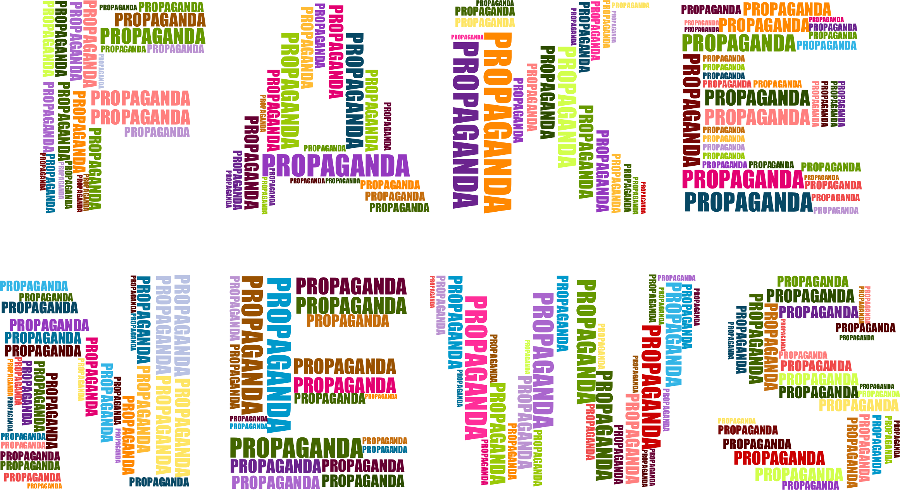
Fake News Detection
By Anna Douville

Slide 2
3. Features
4. Analysis
5. Modeling
1. Problem
2. Data

Slide 3

Problem Statement
In order to stop the spread of fake news, can social media websites use an algorithm that outperforms human fake news detection by using NLP to determine whether an article is real or fake?

Slide 4
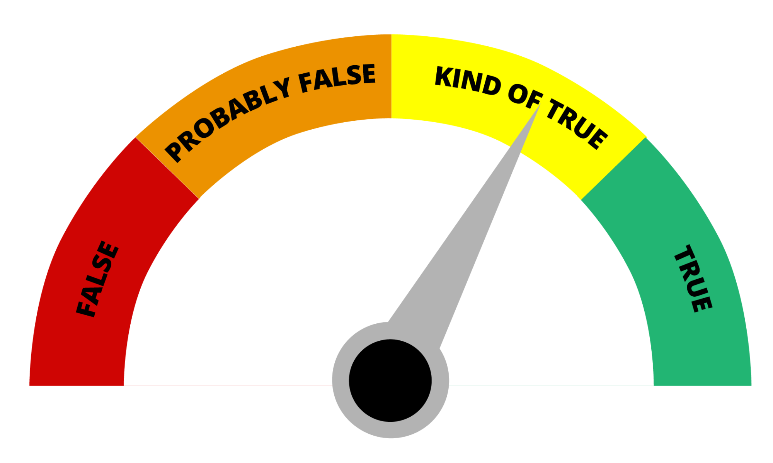
Background
67%
Percent of Americans that use social media as their main news source
Social media has made it easier for fake news to spread
54%
Average accuracy rate of human fake news detection

Slide 5

Effects
Political influence
2016 presidential election
Fear Mongering
Hurricane Irma
Public Safety
COVID-19

Slide 6

Stakeholders
Social Media Websites
Facebook
Instagram
Twitter
Snapchat

Slide 7
3. Features
4. Analysis
5. Modeling
1. Problem
2. Data

Slide 8

The Data
University of Victoria ISOT Lab
21,417 real articles from Reuters
23,481 fake articles from various
fake news websites
4 columns
Date published
Subject
Title
Text

Slide 9

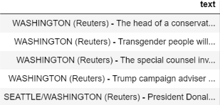
Data Cleaning
Removed beginning phrase from Reuters articles
Dropped subject column
Dropped 5,793 rows of duplicates
39,104 rows total

Slide 10
3. Features
4. Analysis
5. Modeling
1. Problem
2. Data

Slide 11

Basic Feature Extraction
Word counts
Total number of words
Stop words
Upper case words
Average word length
Special character counts
Exclamation marks
Question marks
@ signs
Numbers
Date features
Weekend
Time of year
16 basic features total

Slide 12

TF-IDF Vectorization
Text pre-processing
Made all lowercase
Removed punctuation, numbers,
and stop words
Lemmatization
Included unigrams and bigrams
800 text n-grams
200 title n-grams

Slide 13
3. Features
4. Analysis
5. Modeling
1. Problem
2. Data

Slide 14
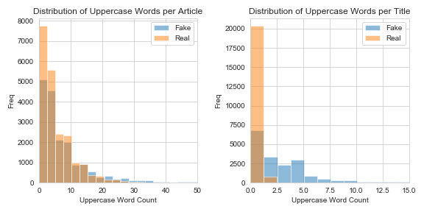
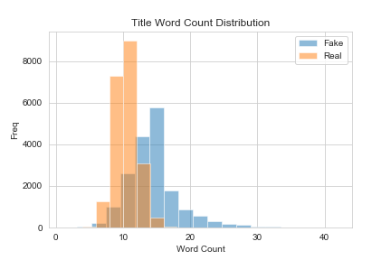
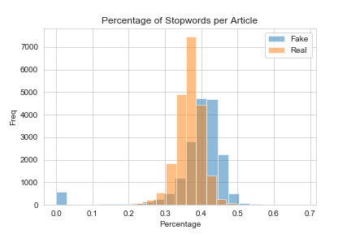

Word Counts
Fake news has...
Longer titles
More stop words
More upper case words

Slide 15
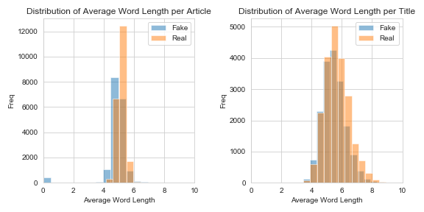

Average Word Length
Real News has slightly longer words on average

Slide 16
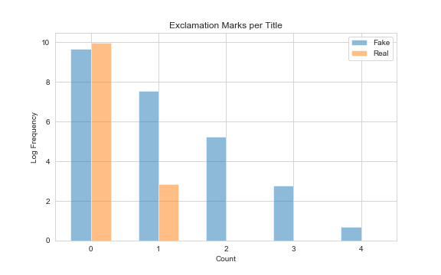

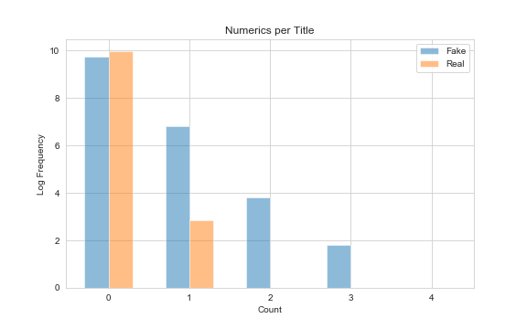
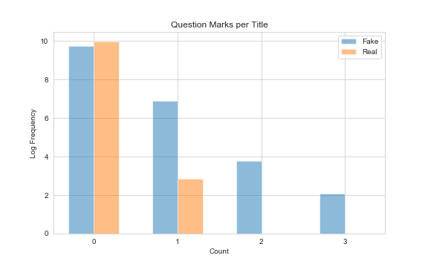
Special Characters
Fake News has more...
Exclamation marks
Question marks
Numbers

Slide 17
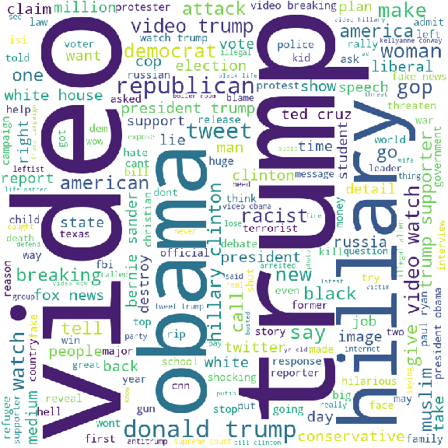
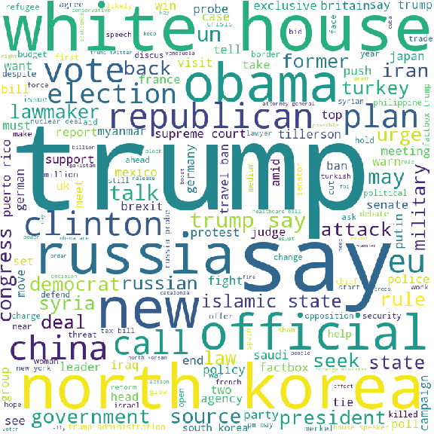
Word Clouds
Fake Titles
True Titles

Slide 18
Word Clouds
Clickbait words
‘watch’, ‘video’, ‘hell’, ‘terrorist’, ‘lie’, ‘breaking’, ‘threaten’, ‘busted’, ‘shocking’, and ‘destroy’
Fake Titles

Slide 19
Word Clouds
Clickbait words
‘watch’, ‘video’, ‘hell’, ‘terrorist’, ‘lie’, ‘breaking’, ‘threaten’, ‘busted’, ‘shocking’, and ‘destroy’
Informal words
‘hillary’, ‘dem’, ‘leftist’
Fake Titles

Slide 20
Word Clouds
Clickbait words
‘watch’, ‘video’, ‘hell’, ‘terrorist’, ‘lie’, ‘breaking’, ‘threaten’, ‘busted’, ‘shocking’, and ‘destroy’
Informal words
‘hillary’, ‘dem’, ‘leftist’
People
‘trump’, ‘hillary’, ‘obama’, ‘ryan paul’, ‘kellyanne conway’, ‘ted cruz’, ‘bernie sanders’
Fake Titles

Slide 21
Word Clouds
Clickbait words
‘watch’, ‘video’, ‘hell’, ‘terrorist’, ‘lie’, ‘breaking’, ‘threaten’, ‘busted’, ‘shocking’, and ‘destroy’
Informal words
‘hillary’, ‘dem’, ‘leftist’
People
‘trump’, ‘hillary’, ‘obama’, ‘ryan paul’, ‘kellyanne conway’, ‘ted cruz’, ‘bernie sanders’
‘fake news’
‘fox news’
Fake Titles

Slide 22
Word Clouds
Places
, ‘north korea’, ‘germany’, ‘iran’, ‘turkey’, ‘japan’, etc.
True Titles

Slide 23
Word Clouds
Places
, ‘north korea’, ‘germany’, ‘iran’, ‘turkey’, ‘japan’, etc.
World news events
‘brexit’, ‘travel ban’, ‘russian probe’, ‘nuclear deal’
True Titles

Slide 24
Word Clouds
Places
, ‘north korea’, ‘germany’, ‘iran’, ‘turkey’, ‘japan’, etc.
World news events
‘brexit’, ‘travel ban’, ‘russian probe’, ‘nuclear deal’
Formal words
‘clinton’, ‘democrat’
True Titles

Slide 25
3. Features
4. Analysis
5. Modeling
1. Problem
2. Data

Slide 26
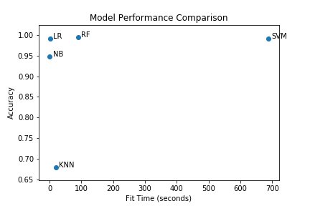

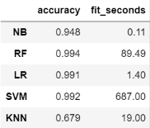
Model Metrics
Logistic Regression performed the best overall r
99.1%
Accuracy

Slide 27

Summary
Key Differences
Word counts
Special character counts
Verbiage
Model
Basic features, TF-IDF
Logistic Regression
>99% accuracy
Applications
Compile a list of fake news websites
Warn users of fake news
Filter out fake news

